Slide 1
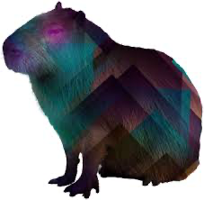
6 YO Dummy Neck
The Capybaras

Slide 2
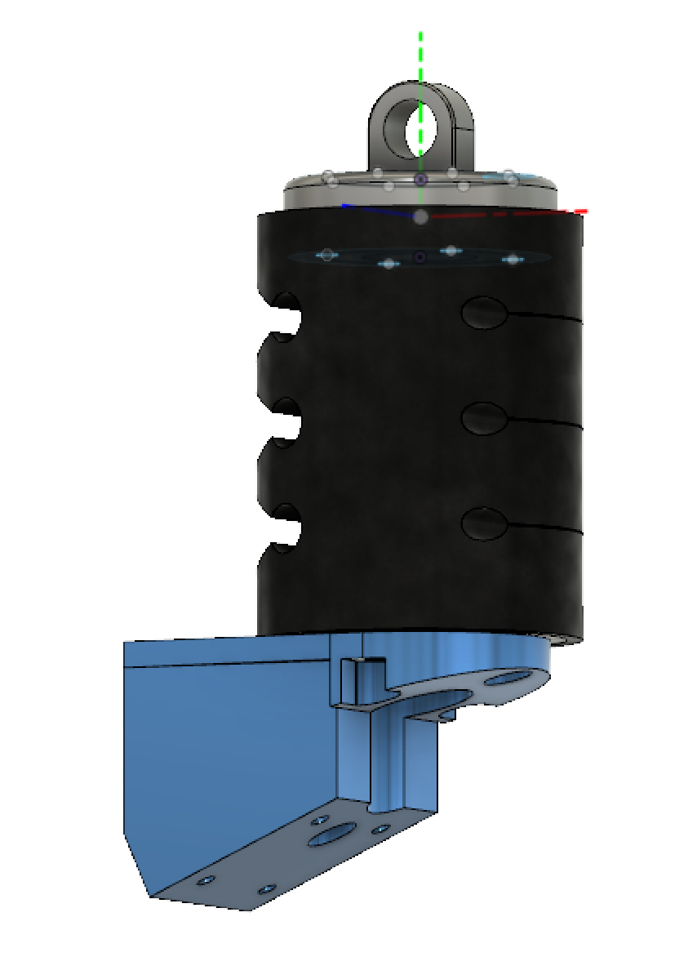
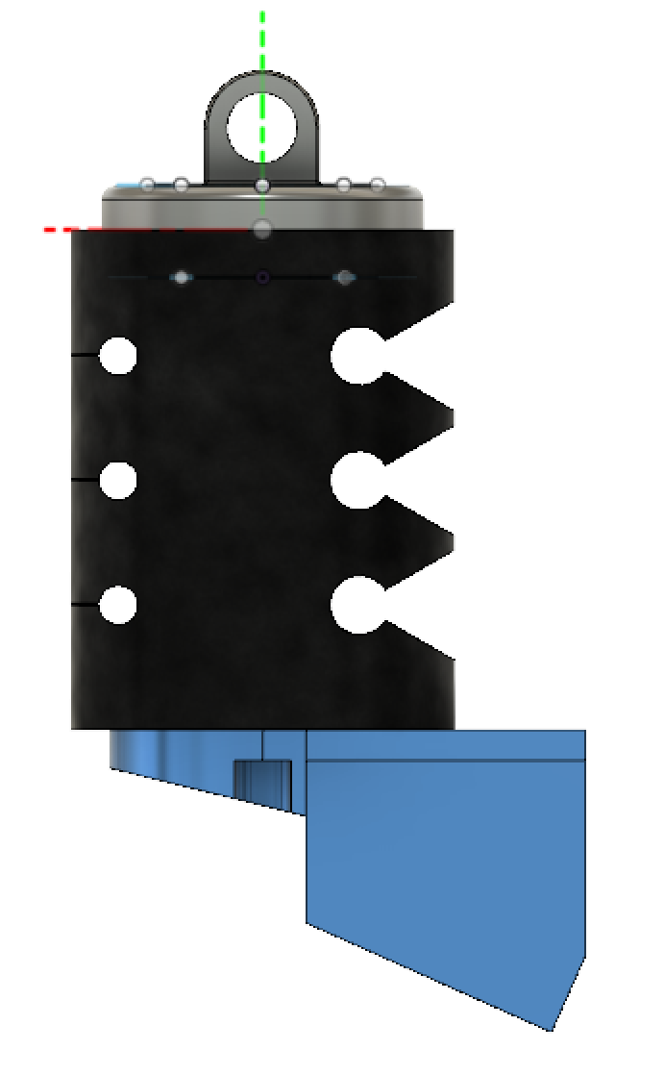
Problem Statement
Need Statement: Design a biologically accurate 6YO neck for applications in evaluation of vehicle safety and understanding injury modes under different loading conditions
Problems with the Hybrid III 6YO Neck Dummy:
Significant cervical spine flexion
Inertial loading is not biofidelic
High overall stiffness of neck dummy
Difference in stiffnesses between UCS and LCS
Lack posterior and anterior translation
Notes:
Jia 20s
Too stiff

Slide 3
Design Specifications | Performance Specifications
Mate with Existing 6YO Head & Torso | Tension
109 mm Maximum Length | Compression
Weight of 1.23 kg | A-P Flexion
Attitude | A-P Extension
Fasteners | NBDL
 | CHOP
*Injury Assessment Reference Values (IARVs) for UCS and LCS were contained within the Performance Specification Corridors
Notes:
Jia 20s
Design: similar weight, be able to work with head and torso
Performance: Corridors for our simulations which we will see later
Notes for Weight Constraint Calculation
Current Hybrid III 6 year old neck weighs 0.544 kg
Adult neck weighs 1.7 kg
Scaled using values from Ommaya et al. (1985) that related to head angular injury criteria used by NHTSA
Head mass scaling ratio of 0.725

Slide 4
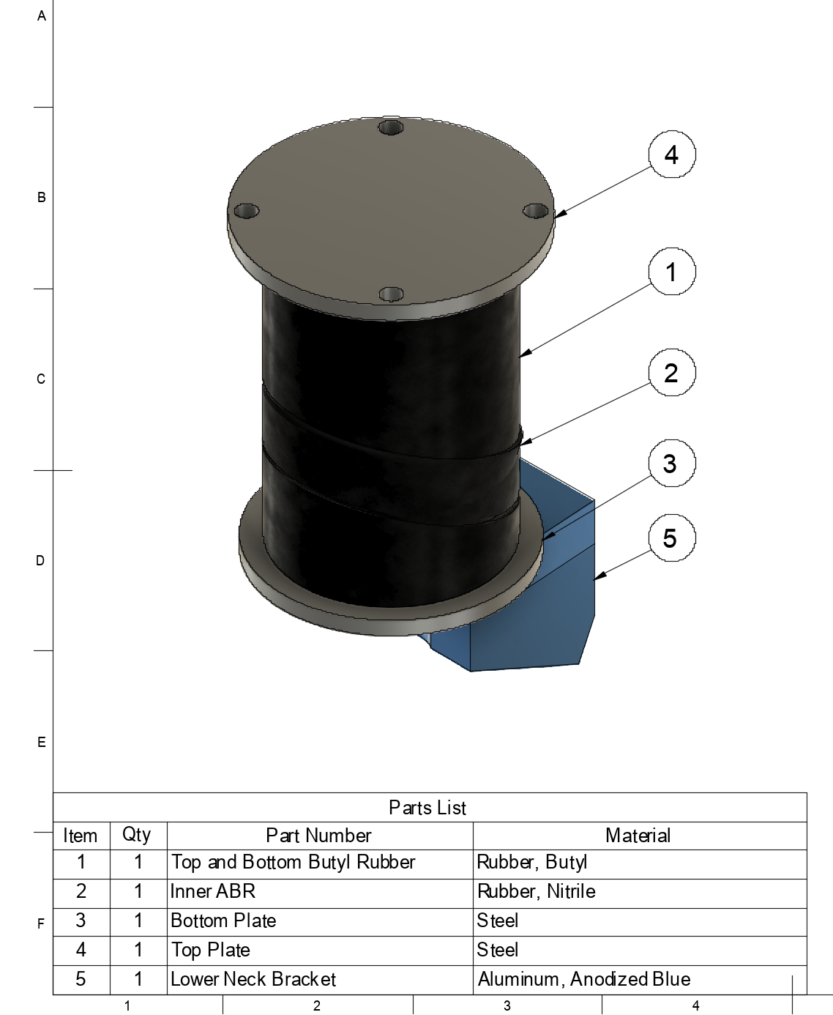
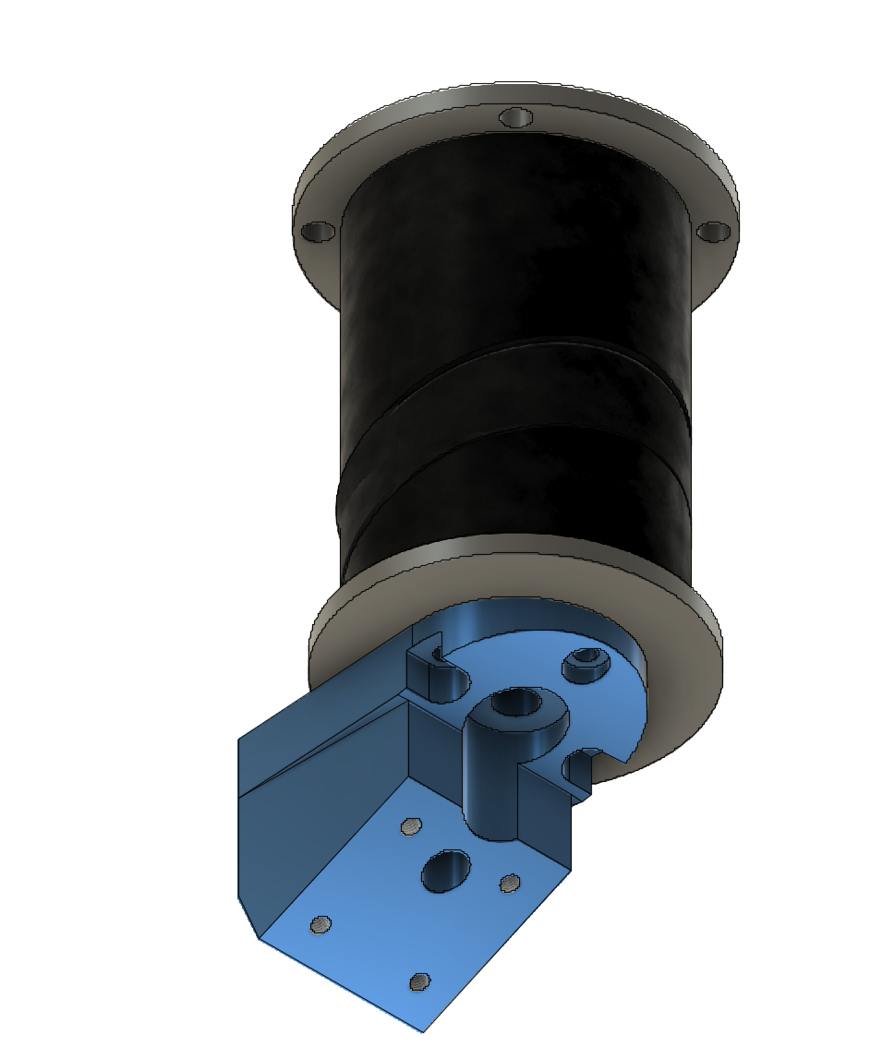
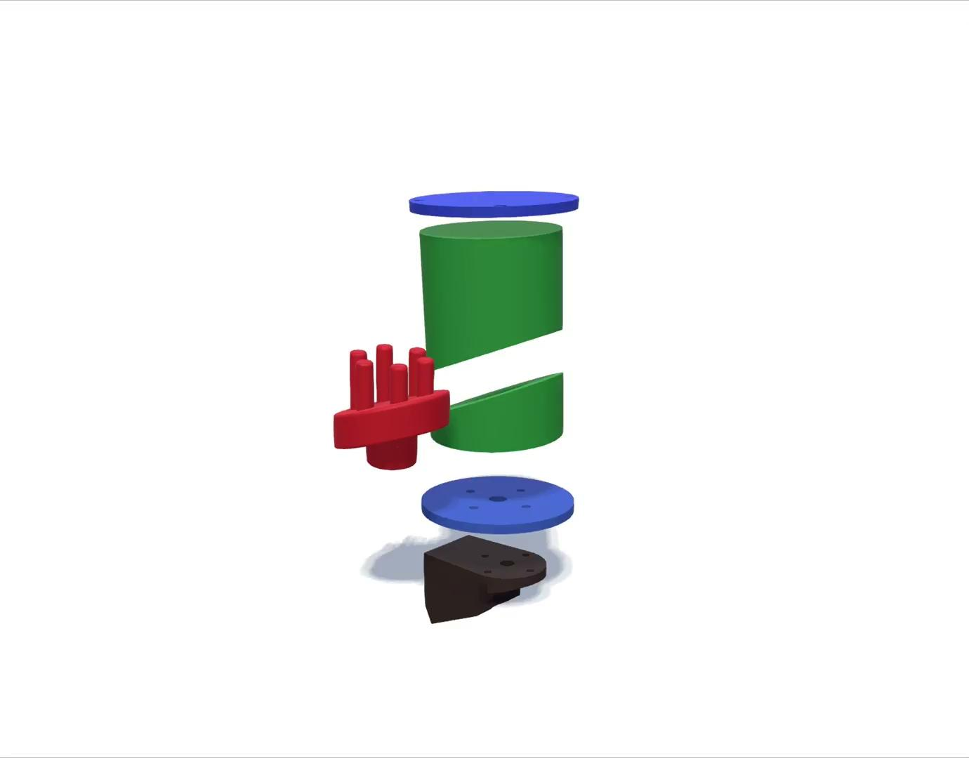
Final Design
Notes:
Ben 50s
The Final Design is a cylindrical outer shape within a top and bottom, 5mm thick, steel plate
The cylinder features the green top and bottom butyl rubber components with a slanted inner ABR disc connected by 6 Titanium Prongs superiorly and 1 wide prong inferioorly

Slide 5
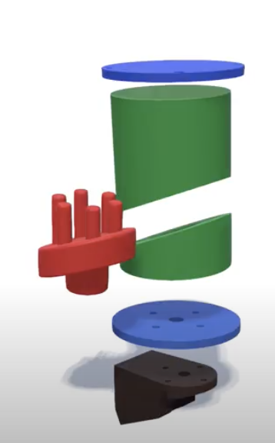
Final Design - Mechanical Features
Motivation | Feature
Sherwood et al. 2003 - Lack of A-P Translation Contributes to High Neck Stiffness | 1. Prongs Do Not Extend to Top Plate - Shear 2. Forward Slant in Middle ABR Rubber - Forward Compression 3. ABR Rubber Mid Section is Below Center Point
Ouyang et al. 2005 - Increased A-P Bending Stiffness in UCS | 4. Upper Prongs are Decentralized (I = I_{cm} + md²)
Luck et al. 2013 - Increased Tension and Compression Stiffness in LCS | 5. Net Cross-Sectional Area of Prongs is greater for Lower Prong (706 vs. 471 mm²)
Increased Stiffness in Flexion vs. Extension | 6. Superior End of Slanted ABR Rubber is Anterior
Strain Stiffening Response in Compression | 7. Use of ABR Rubber in Mid Region and Butyl Rubber in Top and Bottom
LS-DYNA Rigid Bodies Between Deformable Materials | 8. Titanium Prongs
1
4
8
3
2&7
6
5
Notes:
Ben 50s
To reduce the stiffness of the neck, we did not have the prongs go all the way through 1 to allow for some shear which is facilitated by the middle sectio being lower, we had a forward slant in the rubber to allow for some forward motion
We widened the prngs sol the cylindrical moment of inertia in the UCS would be larger to increase the UCZS stiffness
We had a smaller net cross sectional area in the upper prongs to have a smaller comp and tems stiffness in the UCS
The front of the middle rubber in superior to increase flexion stiffnes
The different rubber allowed us to fine tune the stiffening under compression
The titanium prings allowed the conenction of multiple deformable materials

Slide 6
Objective Assessment
Needed a way to compare models and how well they fit the predetermined corridors
Residual and correlation method
Results in a single value greater than 0
0 is ideal score, so lowest score will be considered as the best
Final Design Overall Score: 1.542
Notes:
Will 30s
Keep all objective assessment slides under total of 2 and half minutes
Before going into the simulation results for our final model, I wanted to briefly touch on how we chose this final model in the first place. To compare our multiple iterations, we developed an objective assessment method which comprised of two main components: a residual method (showing how well the data fits the corridor) and a correlation method (adding more information about size). These two method combined gives a final overall score greater than 0, where 0 is the ideal “perfect” score. In our case, we took the lowest score which for our final model was a 1.542

Slide 7
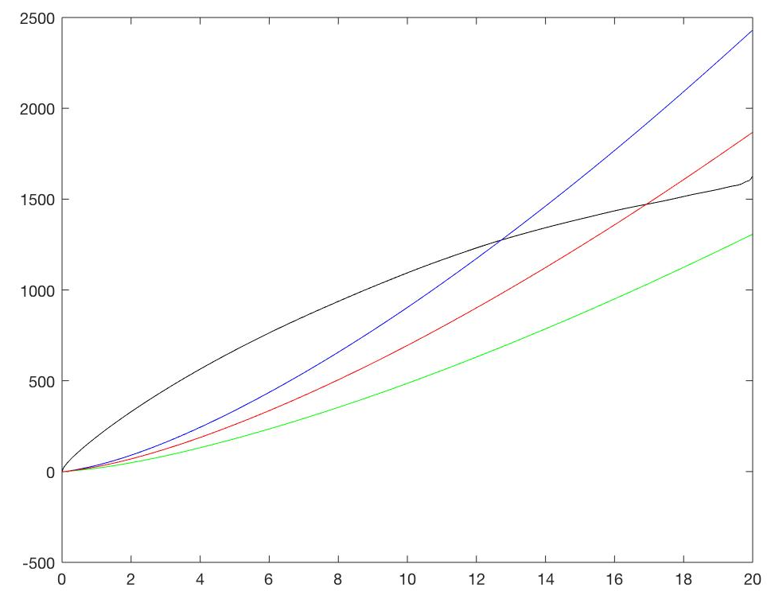
Residual Method
Isolate relevant portion of simulation data
Interpolate to create linear spacing
Recreate corridor curves using fit coefficients
Take difference between simulation data and mean curve
Determine score for individual point
Average across all points to provide one overall score
for the test
Notes:
Will 30s
For all of the tests, the residual method was applied using this general procedure. First, the relevant portion of the simulation data was isolated (loading curve or removing repeating measures at the start or end of each curve). Then the interpolation function in matlab was used to create linear spacing for the curve to avoid having different densities of points at certain portions of the curve. Then this collection of linearly spaced x points was used to recreate the corridors using equations and coefficients generated from the matlab curve fitting app. Then at each point, the difference between the simulation curve and mean curve was calculated and used to determine the residual score (between 0 and 1, look to graph). These scores at each point were then averaged to produce a residual score for the specific test.

Slide 8
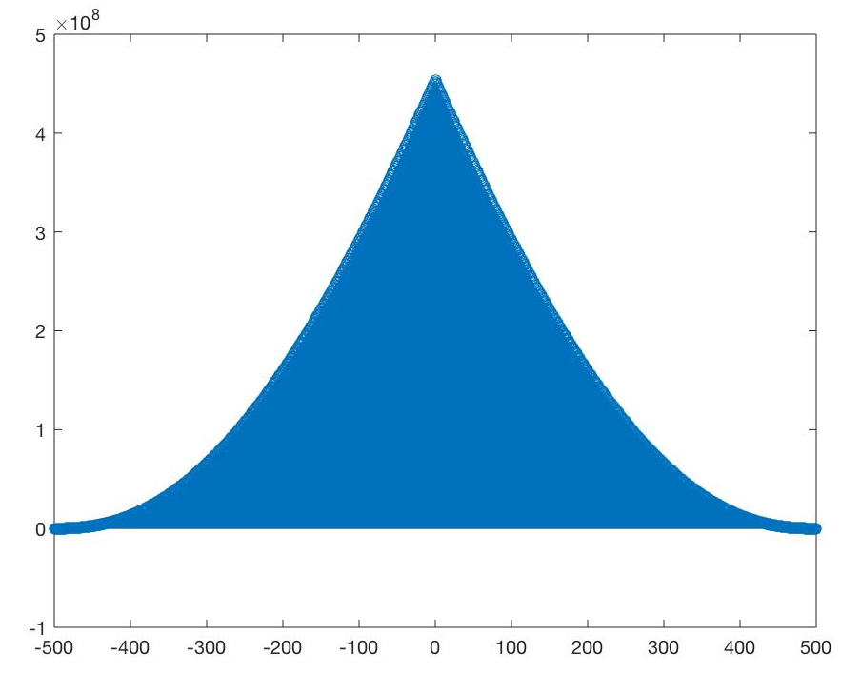
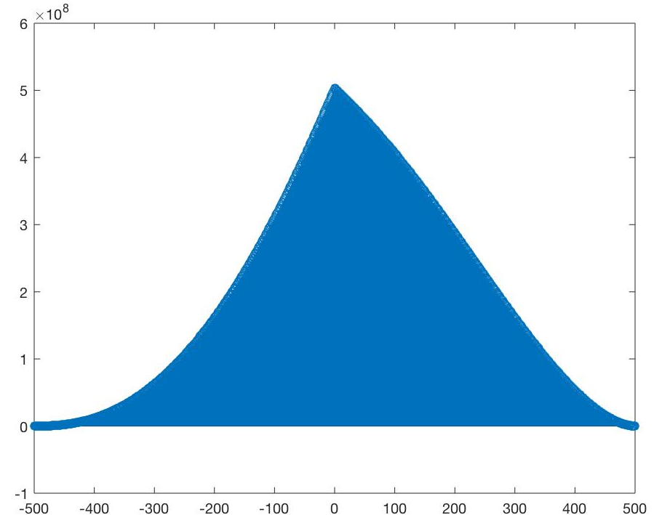
Correlation Method
Autocorrelate mean corridor curve
Cross correlate simulation curve with mean corridor curve
Find percent error between the two using autocorrelation as reference
Notes:
Will 30s
The correlation method was also applied to each test. Here the mean corridor curve was autocorrelated, or cross correlated with itself, which can be seen in the left graph, and then the simulation curve was correlated with the mean corridor curve which can be seen in the right graph. We then summed all the points in each graph and found the percent error between the two using the autocorrelation value as the accepted reference value. The result was a final value greater than 0 that gave us information about the relative size of the curves, such that a lower value would mean greater similarity in size between the two curves.

Slide 9
Strengths | Weaknesses
Same number of points across all tests | Need unique points for simulation data
Linear spacing | Use of NBDL CG timing
Correlation method adds information about size | Correlation method doesn’t fully characterize shape
 | Correlation method score not between 0 and 1
Notes:
Will 30s

Slide 10
Test Weighting
Scale factors used when combining scores from separate tests
Tension: 0.15
Compression: 0.125
CHOP: 0.15
NBDL: 0.25
Extension: 0.125
Flexion: 0.2
Notes:
Leo 15s
Say this is what we arrived at
From literature search of crash incidents failure modes
Nbdl flexion highest
Compression extension lowest

Slide 11
CPU Runtimes and Deformable Elements
Test | CPU Runtime (s)
Tension | 3610
Compression | 3643
NBDL | 8982
CHOP | 13095
Flexion | 7868
Extension | 7978
28112 Total Deformable Elements
Notes:
Leo 15s
Should be 6 minutes in after slide

Slide 12
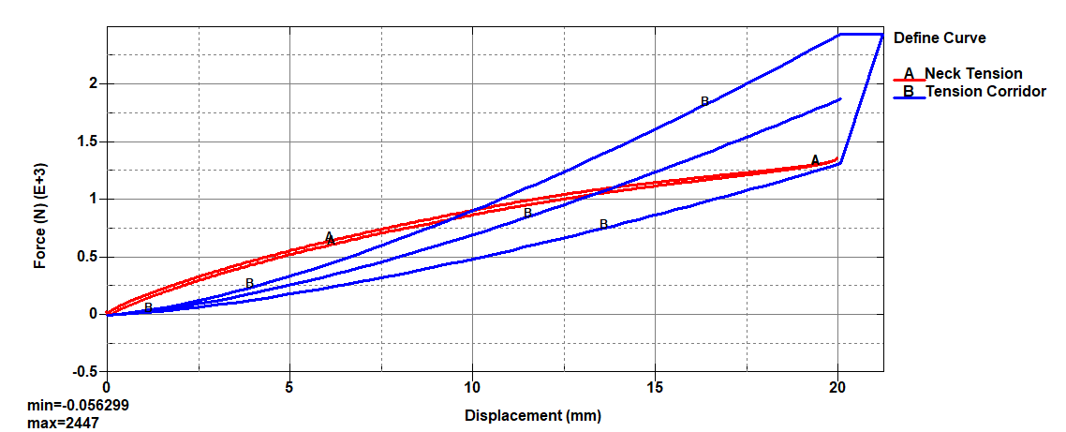
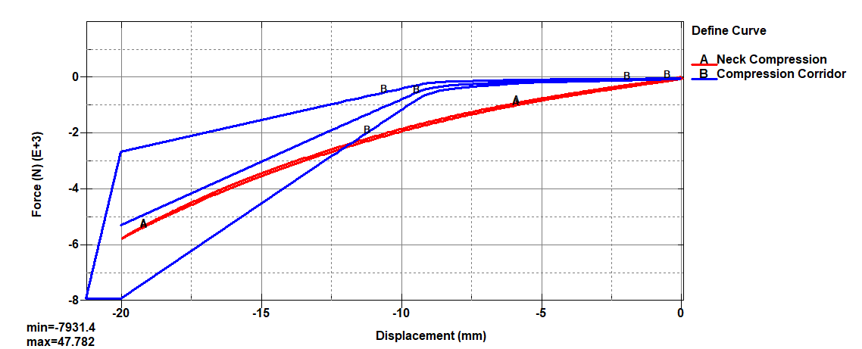
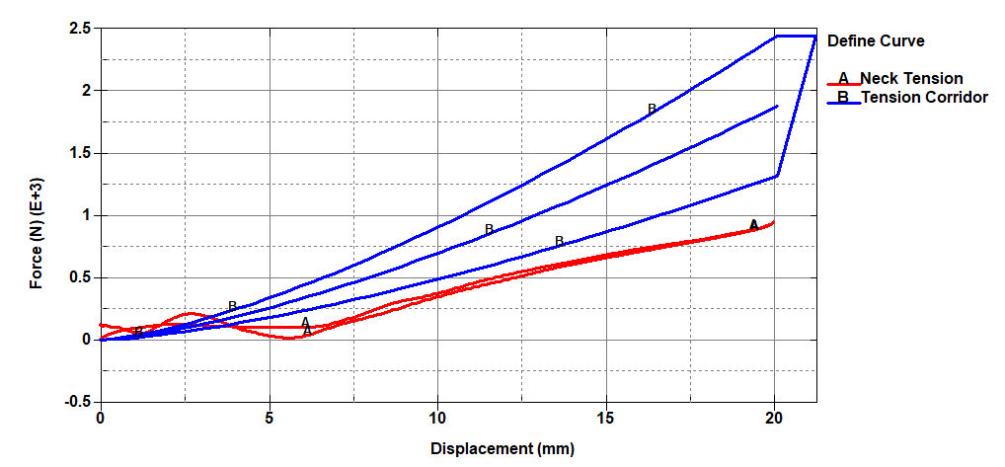
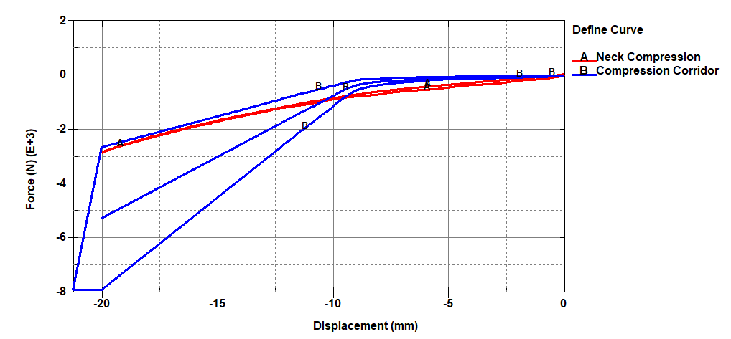
Design Iteration - Translational Joint
Notes:
30-40 seconds
The Tension plot showed promise but translated too much. Additionally, the rubber connection to the top plate still resulted in the neck being too stiff at very low displacements
The compression plot decrease the stiffness in the early stages, but would need to stiffen with some form of stiffer material to meet the corridor at large displacement. The rubber connection also proevented lower forces at low displacements.

Slide 13
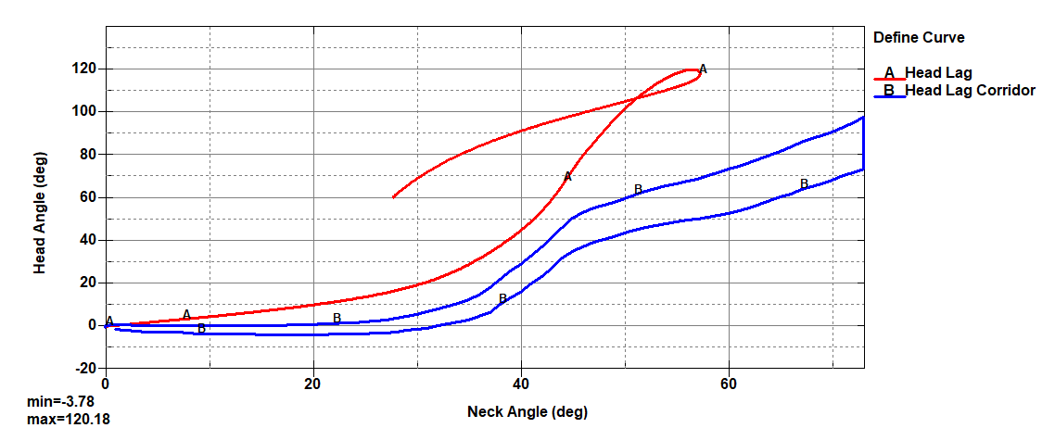
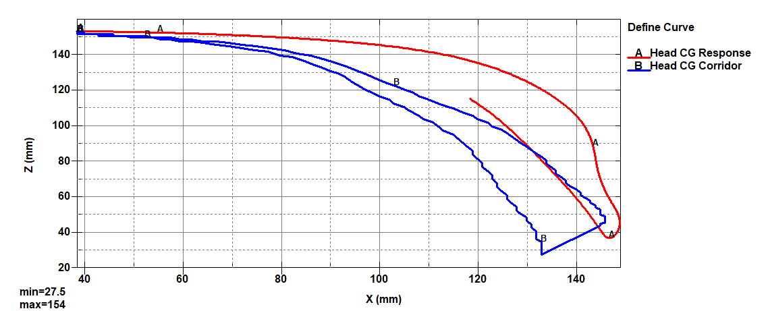
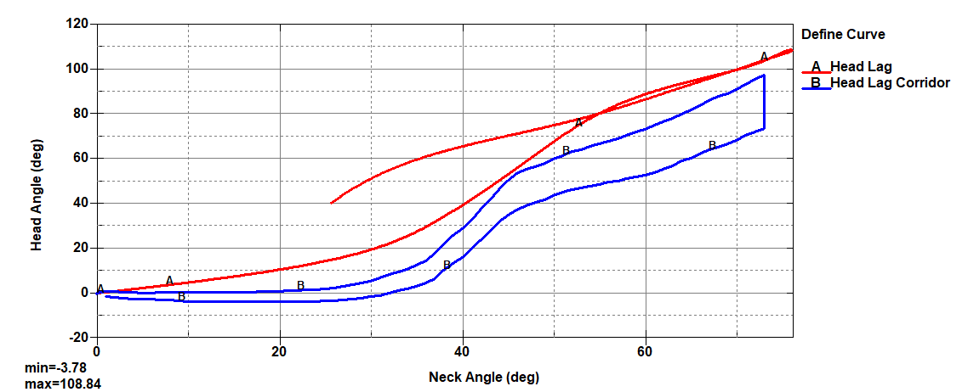
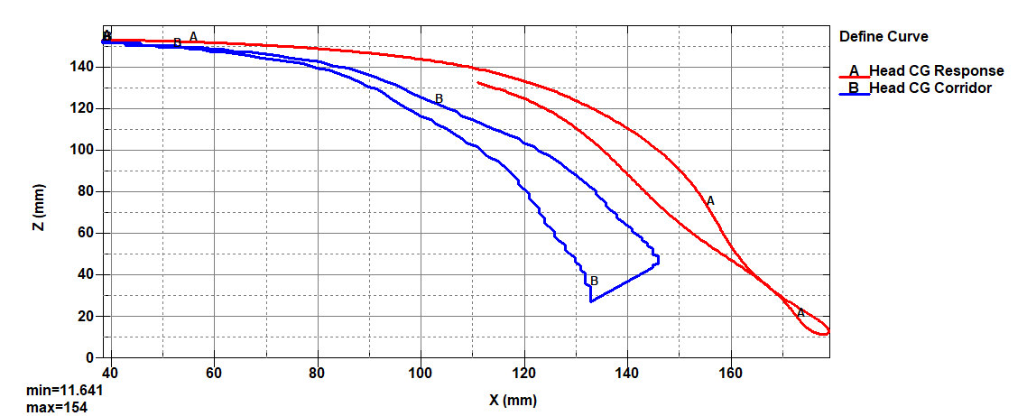
Design Iteration - Revolute Joint
Notes:
Jia: 30-40s
Joint supposed to help with head lag in the beginning
Didn’t improve NBDL
X CG displacement was more severe
(max displacement exceed general maximum) risk hitting the front
Top is Titanium
Bottom is with Revolute Joint and Steel and Thinned structure

Slide 14
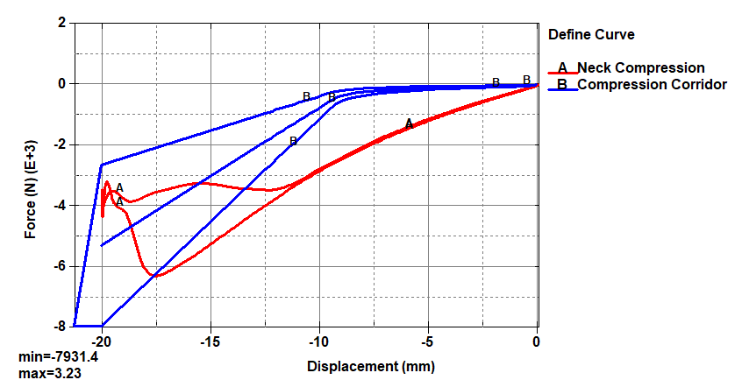
Design Iteration - Revolute Joint
Notes:
Jia: 15s
While nbdl better, cg and compression and tension was not great
Not hitting corridor

Slide 15
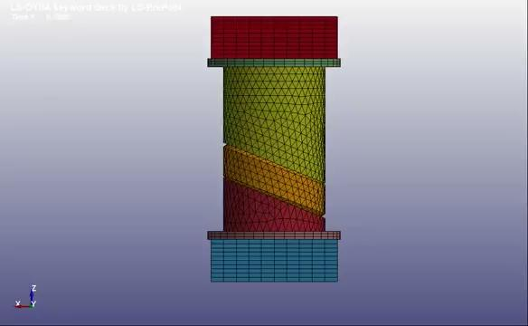
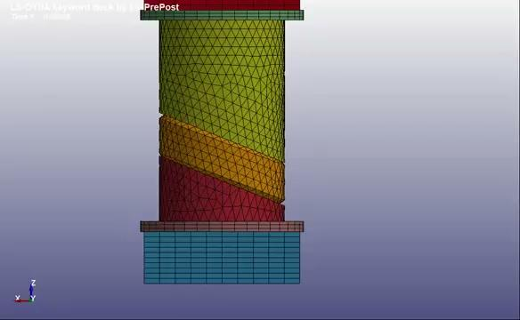
Tension & Compression
Notes:
Leo 15s

Slide 16
Tension & Compression
Notes:
Leo 20s
Too stiff at beginning for tension and compression
Softening
Shorter prongs missed corridor but softer
So we wanted to decouple

Slide 17
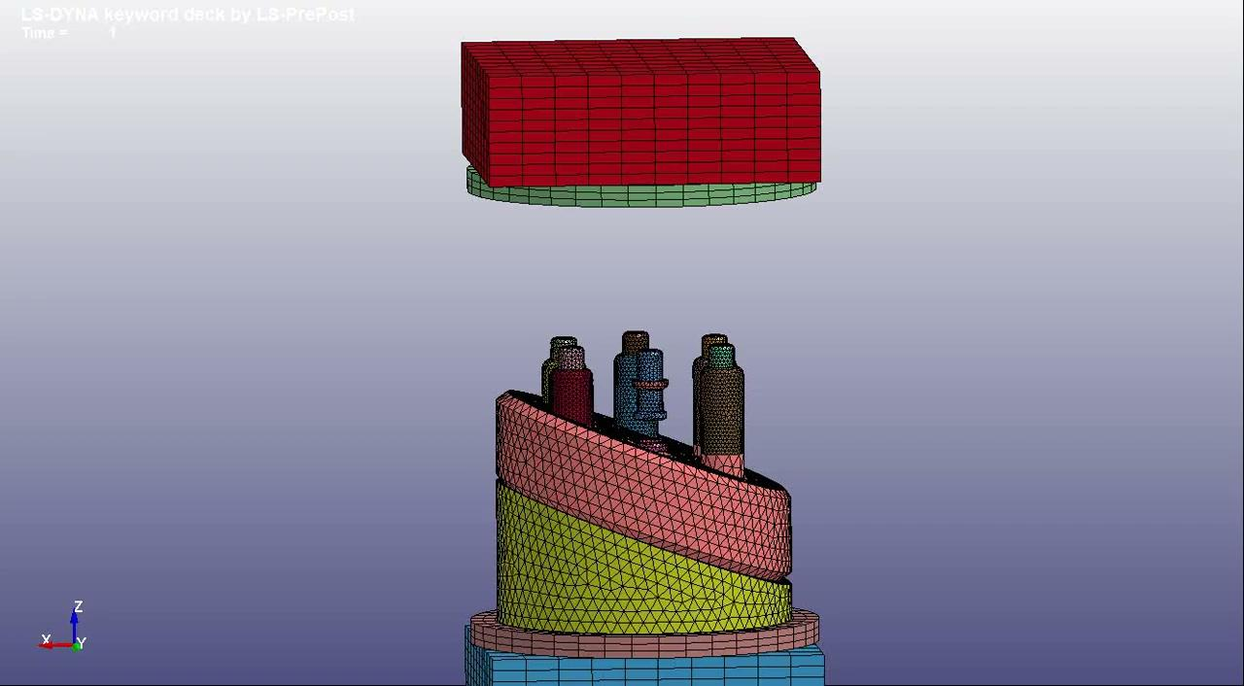
Design Iteration - Translational Joint
Notes:
15 s
In an attempt to reduce the stiffness in the early tensile and compressive loding phases, the prongs were allowed the translate 5 mm in each direction

Slide 18
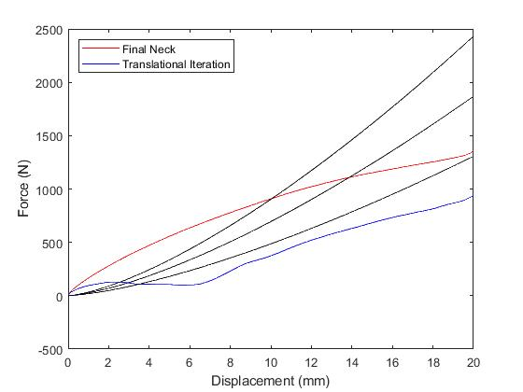
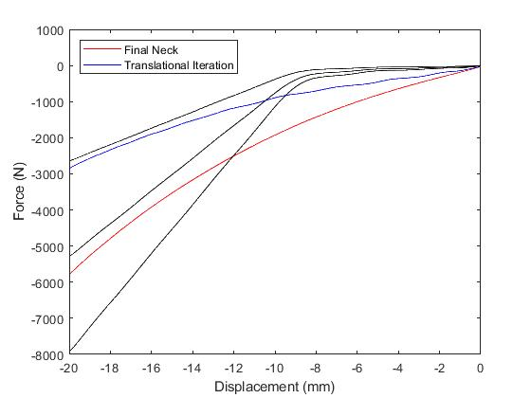
Design Iteration - Translational Joint
Notes:
30-40 seconds
The Tension plot showed promise but translated too much. Additionally, the rubber connection to the top plate still resulted in the neck being too stiff at very low displacements
The compression plot decrease the stiffness in the early stages, but would need to stiffen with some form of stiffer material to meet the corridor at large displacement. The rubber connection also proevented lower forces at low displacements.

Slide 19
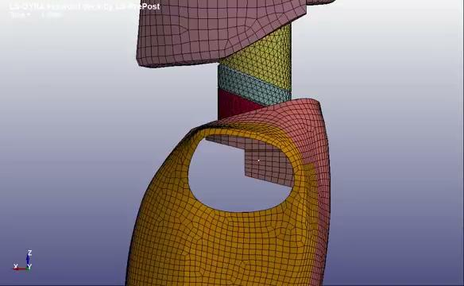
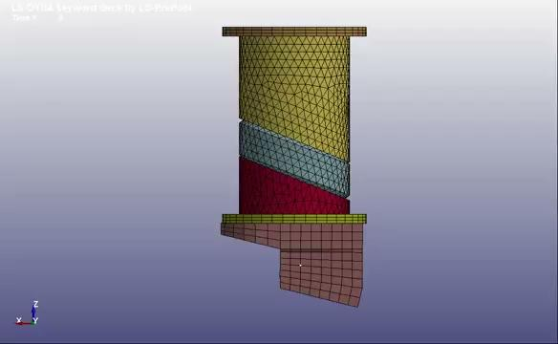
NBDL
Notes:
Ben
Here is NBDL animation

Slide 20
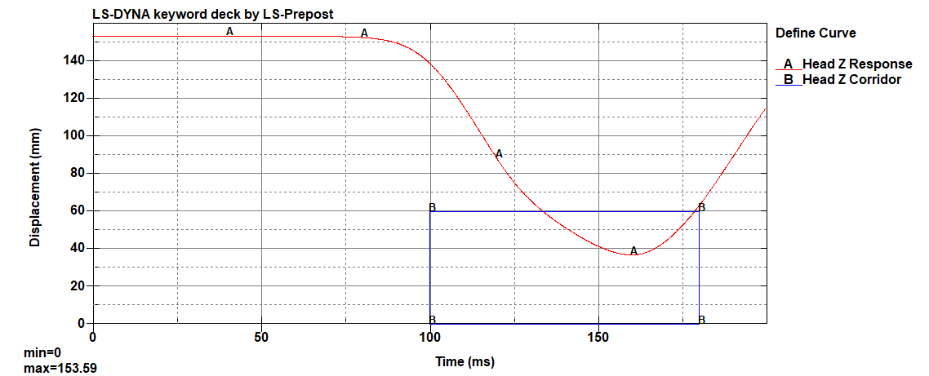
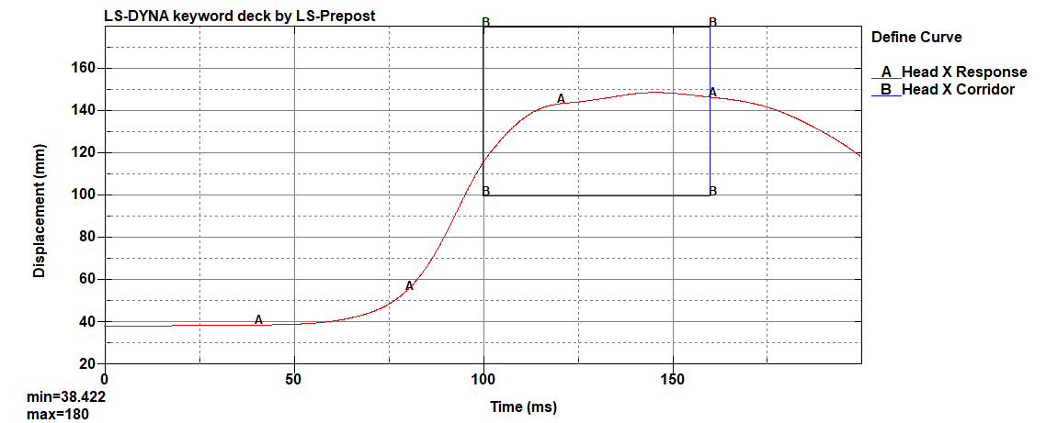
NBDL
Notes:
20 s
The Mac CG displacements were not exceeded, ensuring the model enck would not result in the head hitting the seat in front of it in a non-biological fashion
The head lag featured too large head rotation too early. Jia will mention how we attempted to fix this.

Slide 21
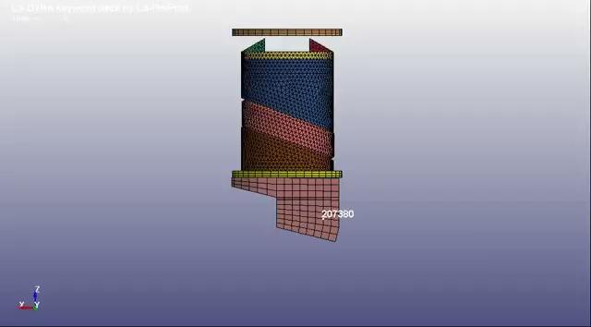
Design Iteration - Revolute Joint
Notes:
Jia
Top is Titanium
Bottom is with Revolute Joint and Steel and Thinned structure

Slide 22
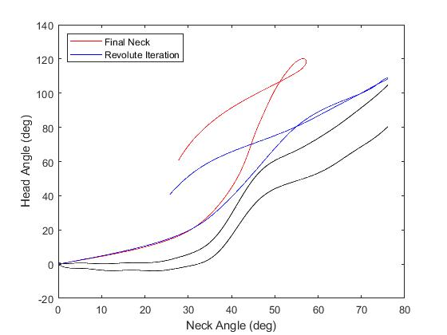
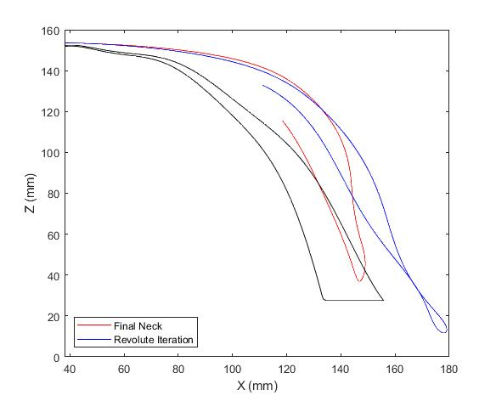
Design Iteration - Revolute Joint
Notes:
Jia: 30-40s
Joint supposed to help with head lag in the beginning
Didn’t improve NBDL
X CG displacement was more severe
(max displacement exceed general maximum) risk hitting the front
Top is Titanium
Bottom is with Revolute Joint and Steel and Thinned structure

Slide 23
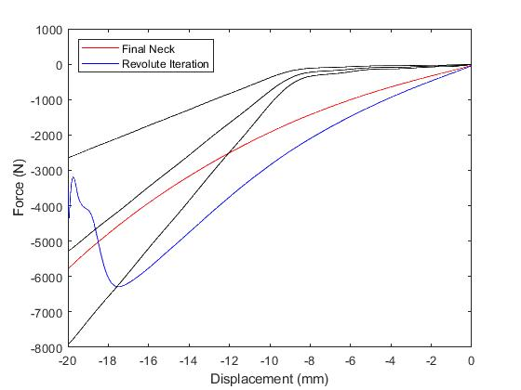
Design Iteration - Revolute Joint
Notes:
Jia: 15s
While nbdl better, cg and compression and tension was not great
Not hitting corridor

Slide 24
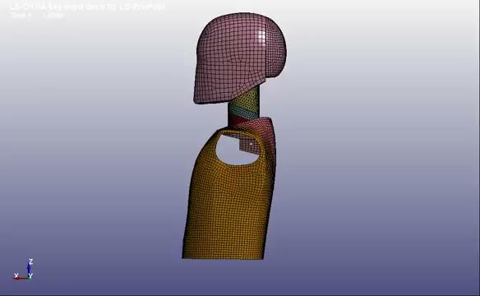
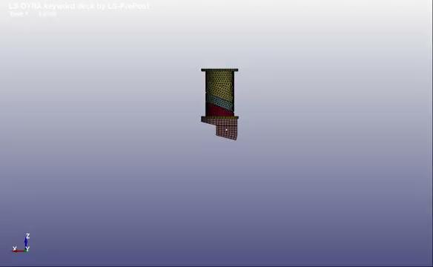
CHOP
Notes:
Will

Slide 25
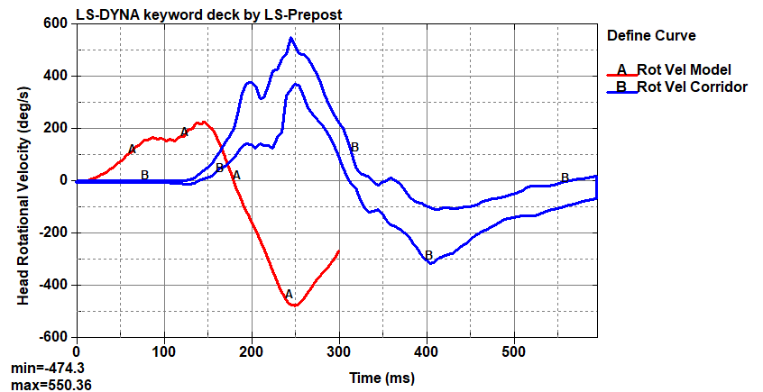
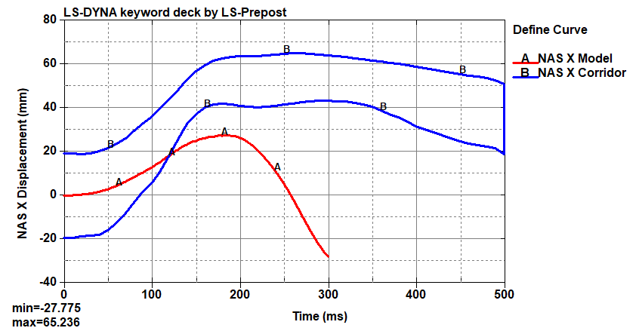
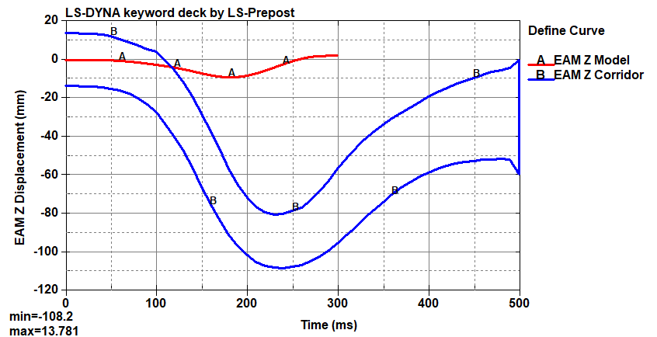
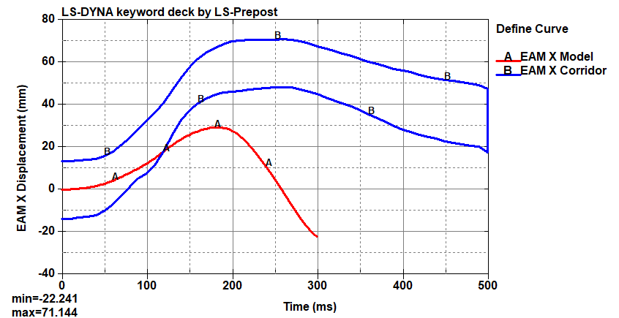
CHOP
Notes:
Will
Not getting nearly as much displacement as we would hope to see at these low velocity impacts. Could be an indication that our model is too stiff overall for these impacts. Part of this issue is that more of our focus was on NBDL because of its increased relevance to injury prevention.

Slide 26
Strengths | Weaknesses
Meets Compression Corridor at Large Displacements | Absence of Strain Stiffening in A-P Bending
Meets Tension Corridor at Medium Displacements | Significant Head Rotation too Early in NBDL Head Lag
Maximum Head CG Displacement from NBDL is within Bounds | Not Enough EAM X and Z or NAS X Displacement from CHOP
Ease of Assembly | Rigid Metal Prongs is Not Entirely Realistic
Hit Extension Corridor | Metal to Rubber Connection is a Weak Connection
 | Titanium Cost & Low Mass
 | Too Stiff in Early Tensile and Compressive Loads
Notes:
Ben 1 minutes
In addition to ease of assembly, the model succeeded in hitting the Extension Corridor, end of the compression corridor, and middle of the tension corridor
The neck also did not exceed maximum displacement limits in NBDL
However the neck did not succeed by first not stiffening under A-P Bending loading mode
There was too much Head rotation in NBDL
Not enough displacement in CHOP
Too stiff in early tension and compression
Rigid Titanium and connection in unrealistic and weak
Additionally the cost of titanium and lower mass than desired

Slide 27
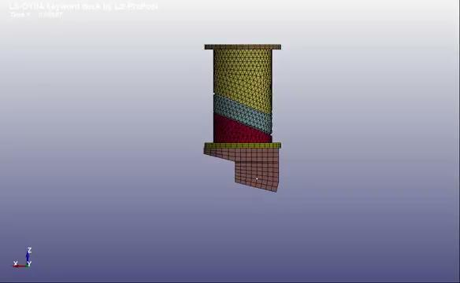
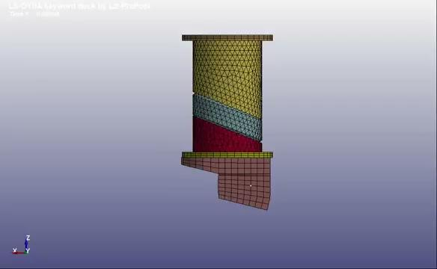
Flexion & Extension
Notes:
Jia:

Slide 28
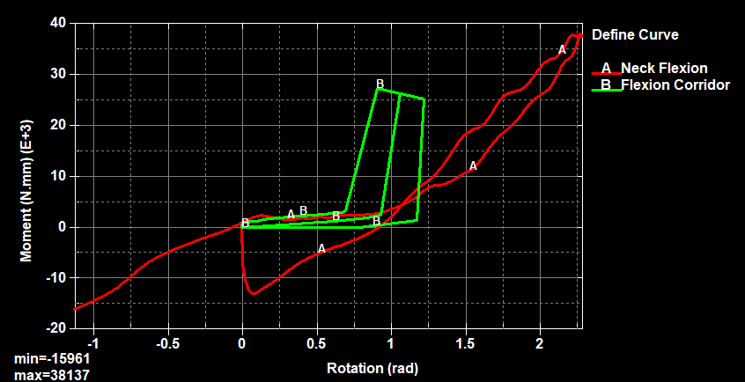
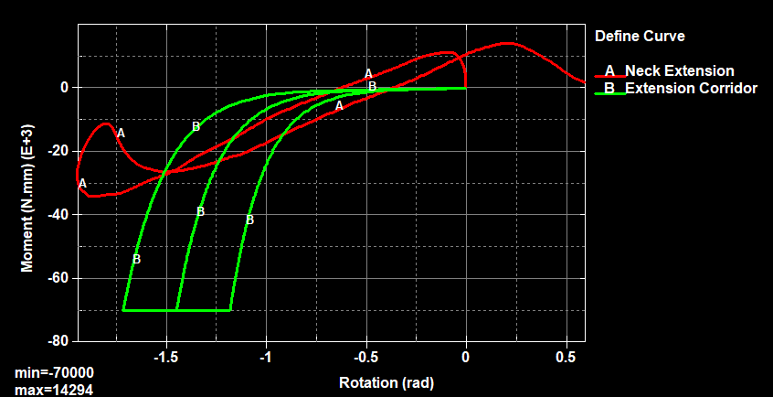
Flexion & Extension
Notes:
Jia: 15s
Hit extension
Not flexion
The absence of stiffening

Slide 29
Mass of Neck
Component | Mass (g)
Total Assembly | 691.8
Inner Foam and Prongs | 247.3
Top and Bottom Butyl Rubber | 30.4
Bottom Plate | 191.4
Top Plate | 222.7
Lower Neck Bracket | 253.7
Notes:
Leo 10s
Using fusion
Assign material to part
Properties
Final mass doesnt include neck bracket

Slide 30
Future Expansions
Starting Simpler
Fix Revolute Joint Iterations
Achieve Head Rotation without Additional X Displacement
Move Revolute Joint >20 mm Anteriorly
Combine Revolute Joint with Translational Joint
Tension Move to Top and Decrease Allowable Distance to Prevent Initial Stiffness from Rubber
Compression Stays the Same but Needs Metal Plate for Stiffer Neck
Add Titanium Insert for Stiffening under Flexion and Extension
Investigate more Viscoelastic Materials
Notes:
Ben 1:30 minutes
Out ultimate change we would have made is being simpler. We reached a point where it was hard to understand how small changes would affect the behavior of the neck.
Nonetheless, with oour current design we hope to fix the revolute joint by potentially moving the joint more anterior to fix the NBDL head lag.
We would also want to have the design sitffen under compression with the translational joints by some stiffer rubber or metal
We also want the tensile translation joint to be above all of the rubber to allower for lower stiffness a tlow displacement\
We would then want to add inserts or a mechanism to stiffen under flexion and extension
Moving forward we would also want to look into materials that behave less stiff under less intense impacts to attempt to hit NBDL

Slide 31
Thank You

Slide 32
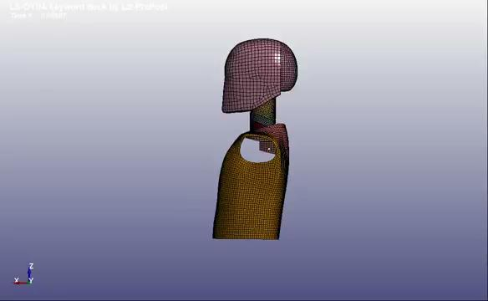
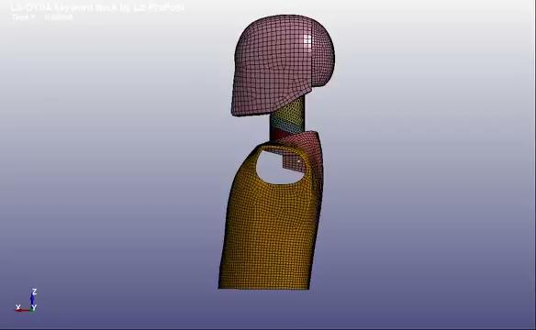
Flexion and Extension Head

Slide 33
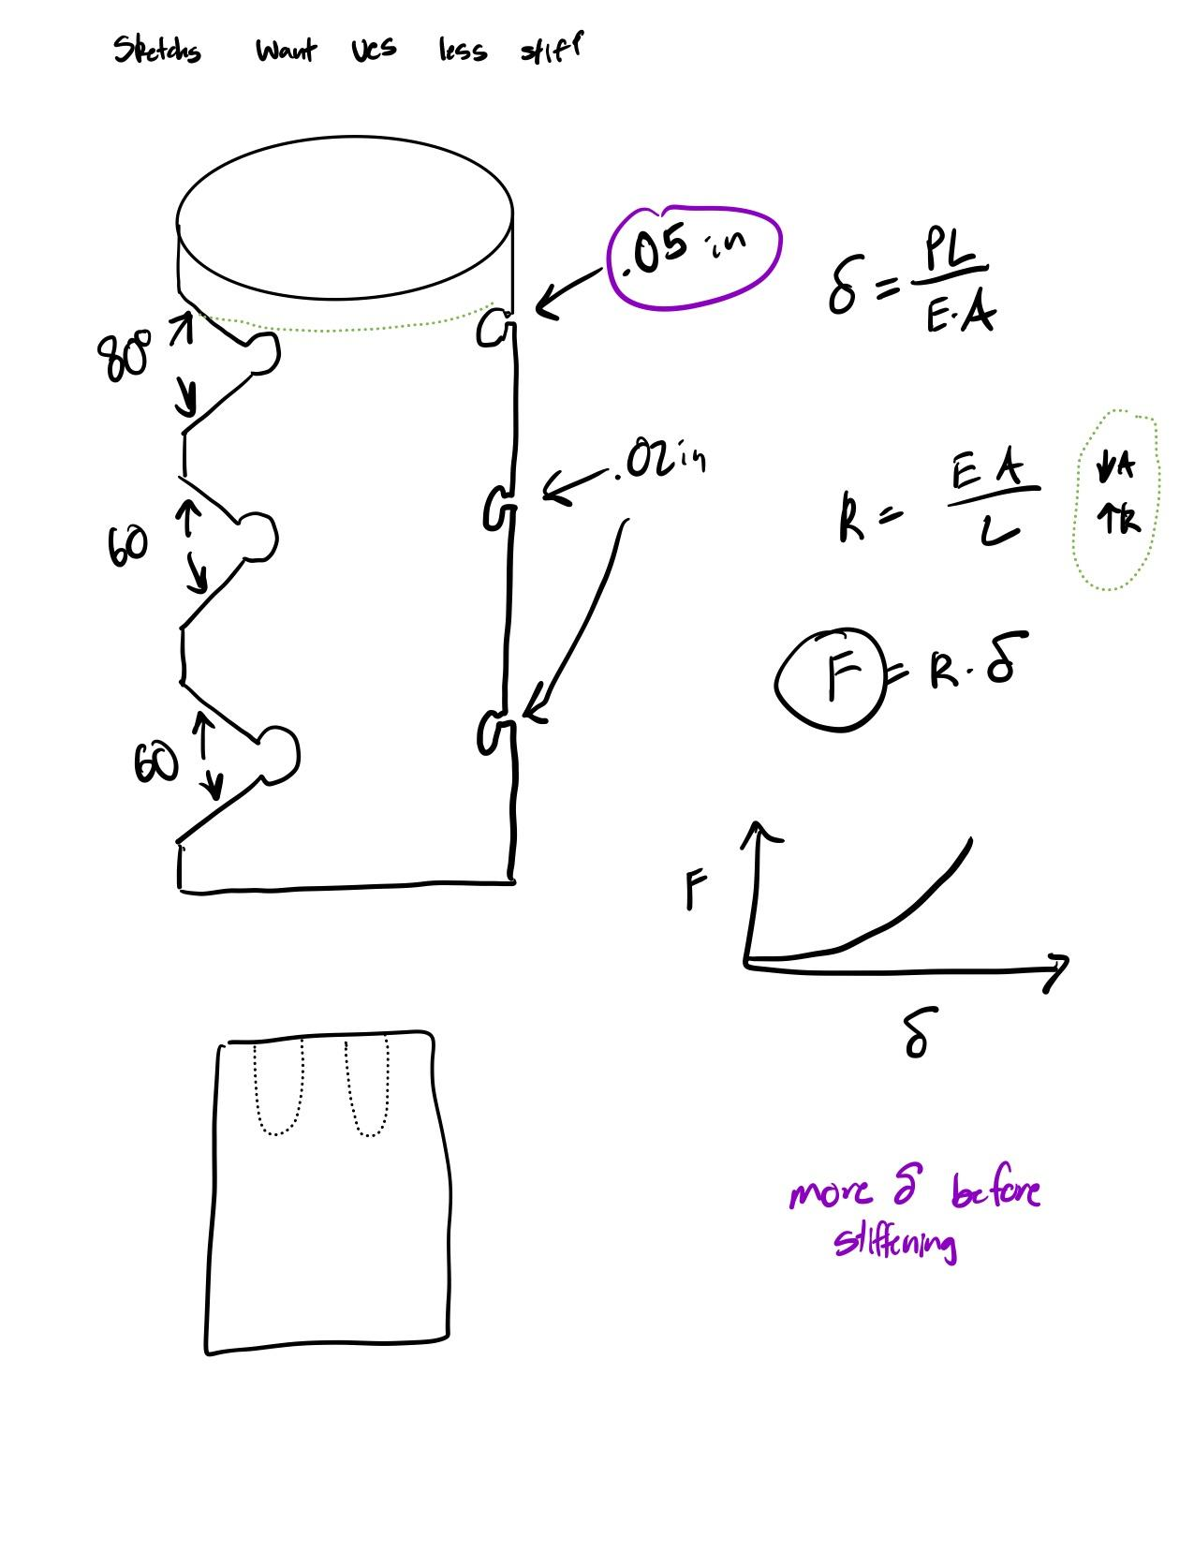
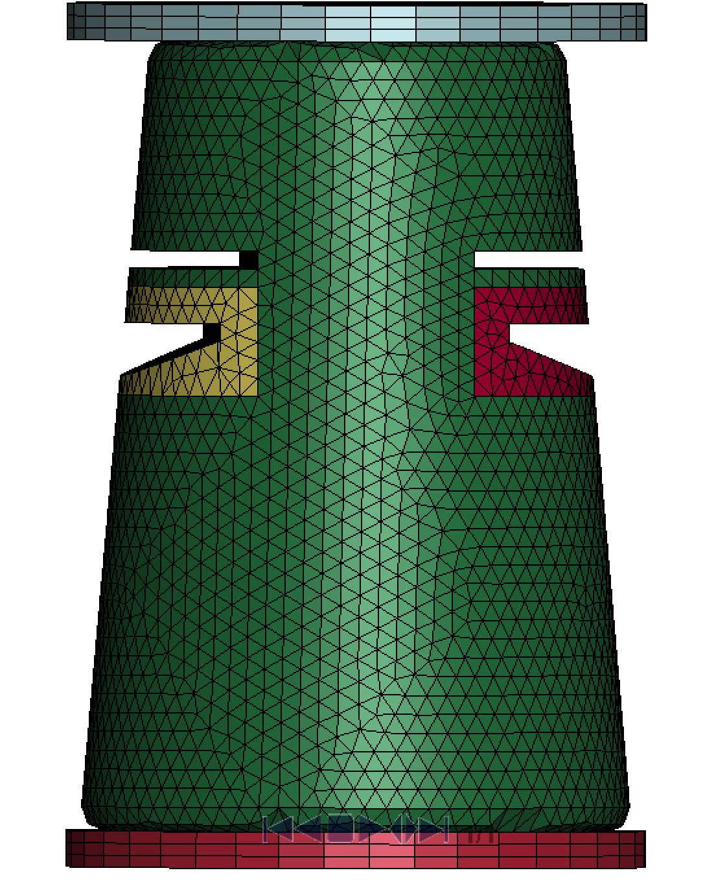
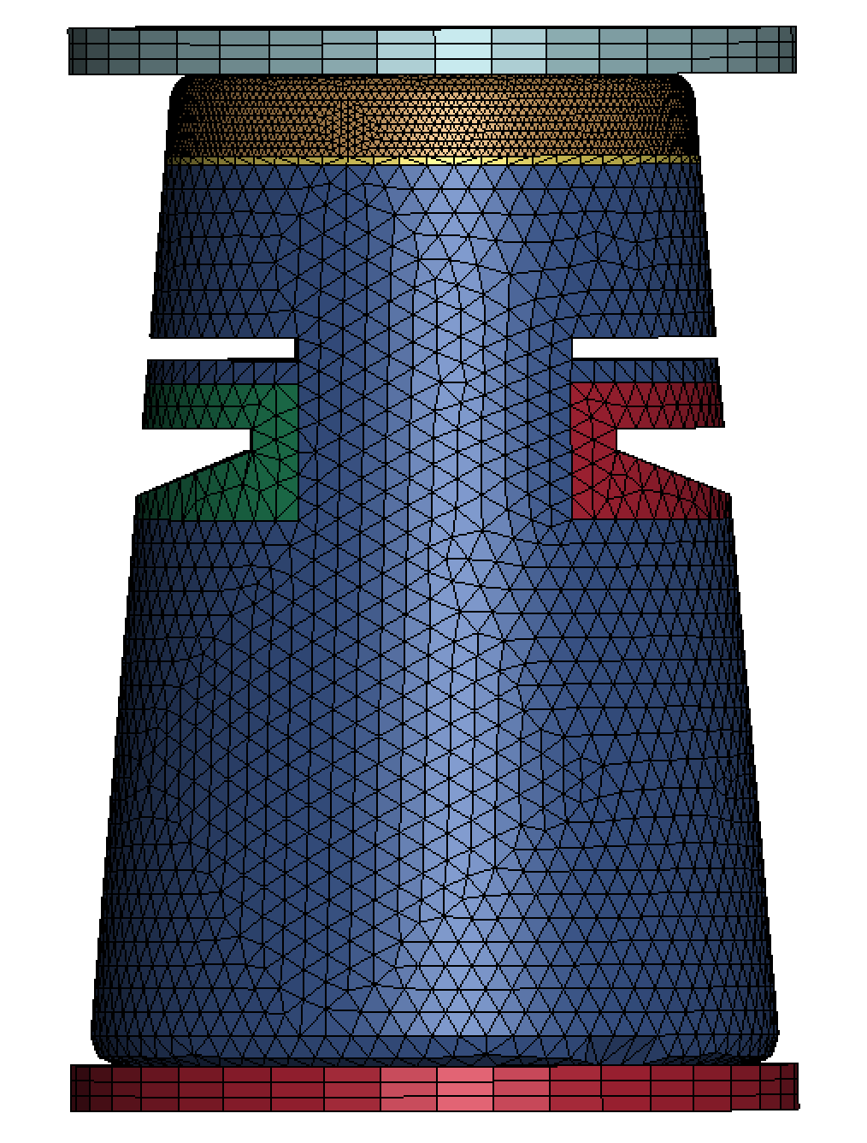
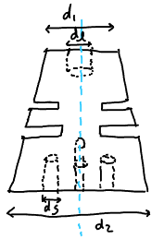
Design Iteration - Power plant design
Initial Sketches:
K-file models:
Iterations:
Different materials
Burn through material
Reasons for Rejection
NBDL
Issues with simulation with burn through material

Slide 34
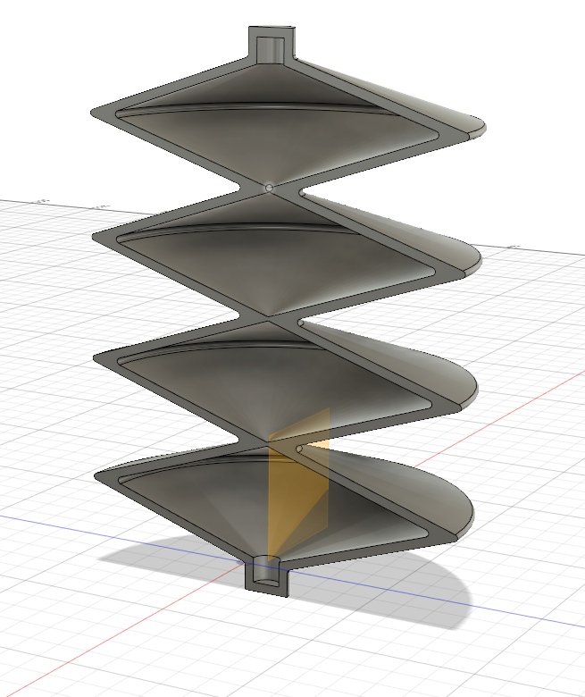
Design Iteration - Crinkle Cut Cylinder

Slide 35
Test Weighting Literature

Slide 36
